Slide 1
Rotary Year 2017-18
Bryce Adam, Governor
Membership Goals

Slide 2
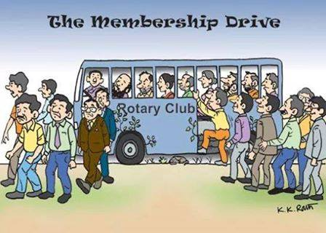

Slide 3
MEMBERSHIP
3 Words
3 Days
3 New
3% Net
2017-18
MEMBERSHIP GOAL
The Year of 3’s

Slide 4
What is Your
Rotary Club Brand ?
What 3 Words Define YOUR Rotary Club??
You must know who you are as a club before you can meaningfully “promote” club membership!
Notes:
You have gone a long way in addressing this question, “Why would anyone want to join the Hartford City Rotary Club.
You invited Thaddeus to come talk to you about branding.
This is a bit of a review
What is the value of the Hartford City Rotary Club? What sets it apart from all of the other service clubs in H.C.?

Slide 5
LEADERS
IDEAS
ACTION
District 6560
DGE Bryce Adam’s 3 words defining Rotary

Slide 6
So, Now What?
3 MEETINGS WITH A PROGRAM
PLANNED AROUND ONE OF YOUR 3 WORDS
Be creative

Slide 7
And the Goal Is?
At Least 3 New Members
2017-18

Slide 8
Compile List of Membership Prospects
Be Strategic
Which Meeting Topic Would Interest Your Prospects?
Ask!

Slide 9
And the Goal Is?
3% District Membership Growth
In the past 5 years Rotary membership has dropped in our district from 2586 to 2140

Slide 10
The 3 E’s
Engage members in defining your
club’s “3 Words”
Energize them to “sell” the brand to
potential members
Experience growth in your clubs

Slide 11
Resources
(Each PE received this manual at PETS and should have passed it on to the incoming Chair. It is also available on line.
Lead Your Club: Membership Committee
https://my.rotary.org/en/document/lead-your-club-membershiop-committee
Be a Vibrant Club
https://my.rotary.org/en/document/be-vibrant-club-your-club-leadership-plan-north-america-245-a
Connect for Good
https://my.rotary.org/en/document/connect-good
Membership Assessment Tools
https://my.rotary.org/en/document/membership-assessment-tools
Strengthening Your Membership: Creating Your Membership Development Plan
https://my.rotary.org/en/document/strengthening-your-membership-creating-your-membership-development-plan

Slide 12
Resources
Introducing New Members to Rotary: An Orientation Guide
https://my.rotary.org/en/document/introducing-new-members-rotary-orientation-guide
Member Satisfaction Survey
https://my.rotary.org/en/document/enhancing-club-experience-member-satisfaction-survey
Survey Monkey - You can type any survey you create into Survey Monkey and it will do all the work for you. It’s free up to 10 questions.
www.surveymonkey.com
Vicki Tague – District 6560 Membership Chair
260-726-7242 (h)
260-726-5606 (c)
victoriat@centurylink.net

